Slide 2
Topics include:
Officer names
Number of members (if you have a trend for the past 4 years using SAMIEEE, please plot)
Best Practices
Activities/Highlight activities

Slide 3
IEEE Singapore EMC Chapter
Chapter committee: Richard Xian-Ke Gao (Chair)
Eng Kee Chua (Vice-Chair)
En-Xiao Liu (Treasurer)
Si-Ping Gao (Secretary)
Er-Ping Li
Kye Yak See
Jun Hong Deng
Wee Jin Koh
Seow Chiang Yan
Lin Biao Wang
Number of chapter members: 32 (active)

Slide 4
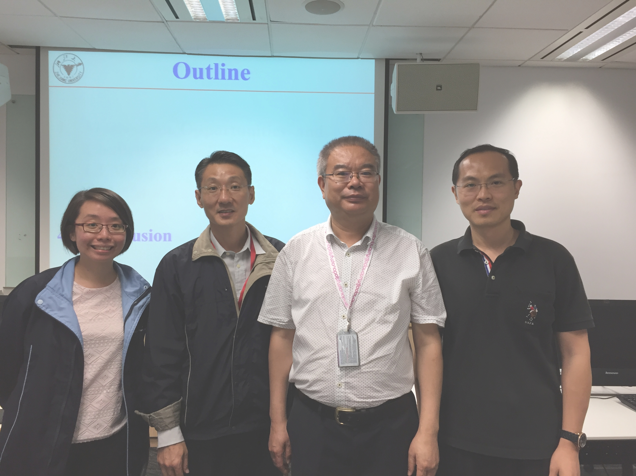
“From Computational Electromagnetics to Multiphysics Methods: Capabilities, Challenges and Opportunities” Prof. Wen-Yan Yin, IEEE Fellow, Zhejiang University, China
In this seminar, different CEM/MP methods have been introduced and implemented for studying on various multiscale/heterogeneous structures, from electrically large warship to RF power amplifier (PA), 2-D material-based metasurfaces/frequency selective surfaces (FSS), new generation memory and solar cells. Challenges and opportunities have also been demonstrated by both numerical and experimental ways.

Slide 5
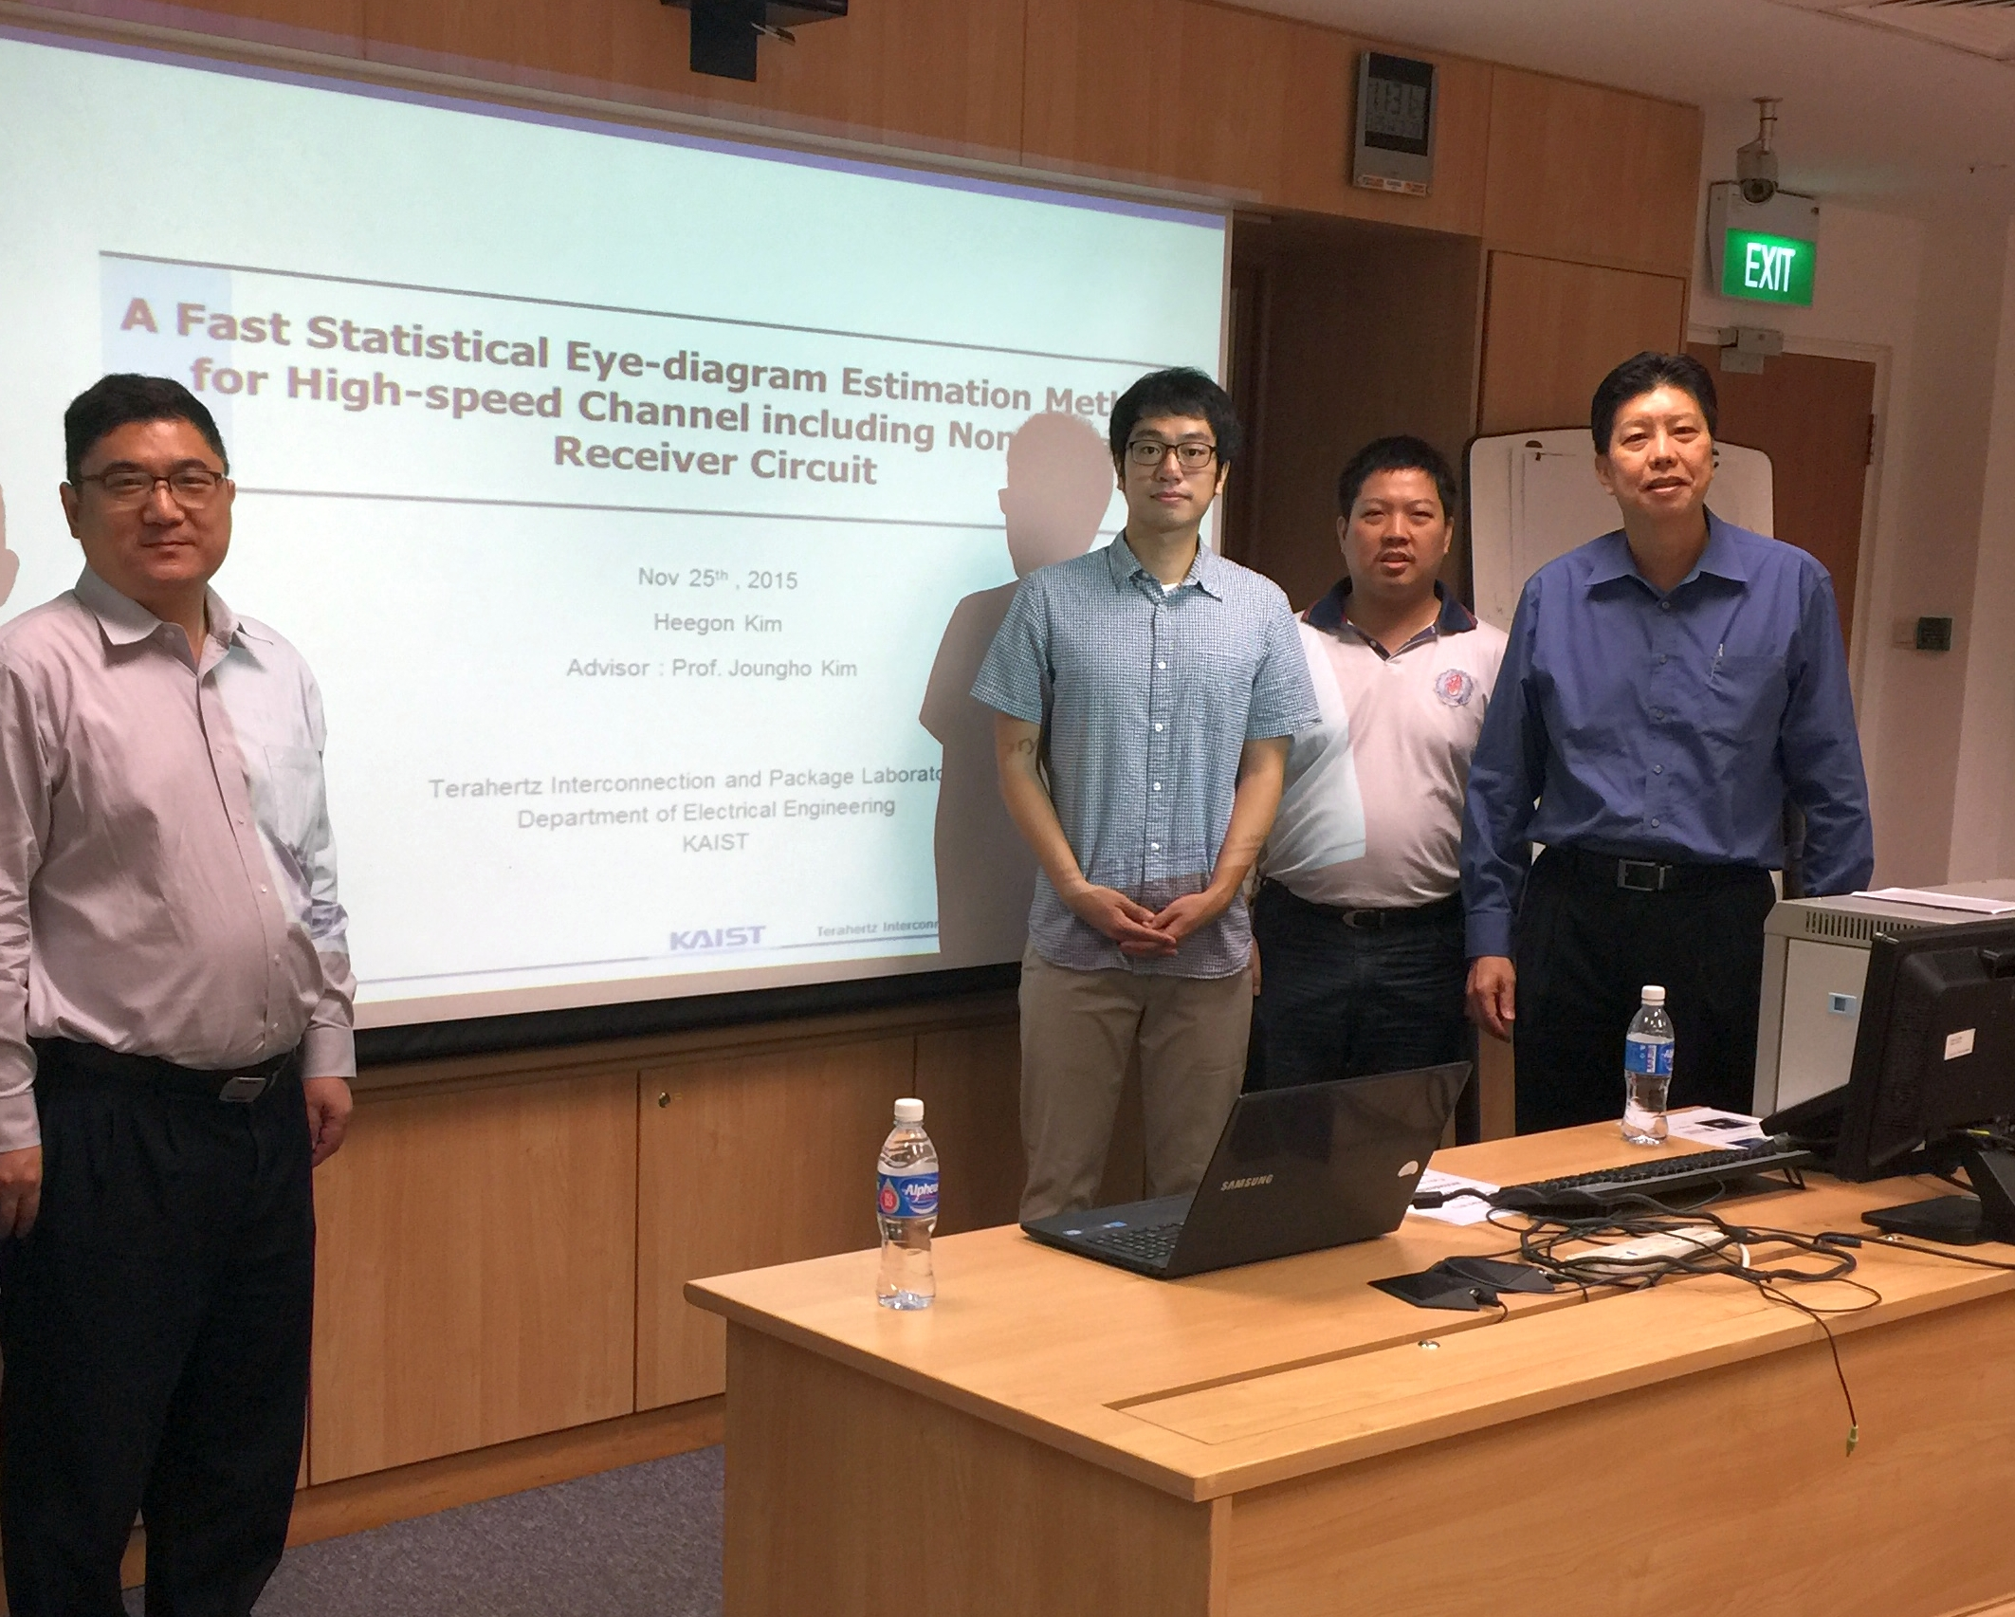
“A Fast Statistical Eye-diagram Estimation Method for High-speed Channel including Non-linear Receiver Circuit” Dr. Heegong Kim, TERA Laboratory, KAIST, South Korea
A fast statistical eye-diagram estimation method for the signal integrity analysis of the high-speed single-ended channel was introduced. For fast BER calculation, the optimal-sized sets of receiver input and external noises for one unit-interval are employed. Different from conventional statistical method, this method covered non-linear part of the high-speed channel, suitable for fast and accurate statistical eye-diagram estimation.

Slide 6
“2015 Richard Stoddart Award for Outstanding Performance”
Professor Er-Ping Li

Slide 7
“Best Symposium Paper” in APEMC 2016
Dr. Si-Ping Gao, Dr. Richard Xian-Ke Gao, Dr. En-Xiao Liu, and et al.

Slide 8
Thank you!

